Slide 1

Computational Intelligence and innovations in Learning Algorithms
Presented by:
Dr. Aruna Tiwari
Discipline of Computer Science & Engineering
Indian Institute of Technology Indore
Indian Institute of Technology Indore

Slide 2
Symbolic AI to Computational AI
Why ?
What?
Topics-
  Artificial Neural Networks (ANN)
  Fuzzy Systems (FS)
  Evolutionary Computation (EC)
Aruna Tiwari, IIT Indore

Slide 3
Architecture of an expert
reasoning system (Symbolic AI)
Inference Engine
Output
Input
Knowledge Base
Expert Reasoning System

Slide 4
What is Computational Intelligence?
Alternative terms:
  Advanced Artificial Intelligence
  Natural Computation
  Nature-Inspired Computing
  Soft Computing
  Adaptive Systems

Slide 5
Switching to Computational Intelligence
Traditional AI (Symbolic AI)
  uncertainty, or missing information
  noisy/erroneous information
  the analogue world
    temporal change, inexact, adaptive

Slide 6
Yet humans and other animals do amazingly well
Huge complexity
  extraction of important features from masses of information
Abstraction from detail
  dealing with uncertainty, inexactness, noise, incompleteness
  Recognize patterns, machines do everything with numbers !!!

Slide 7
So how do we get computers to do these things?

Slide 8
Natural Computation
Nature is a remarkable problem solver.
the mechanisms of construction, adaptation, learning, and
co-operative behavior found in nature have solved a vast array
of problems in very challenging environments.
Natural Computation is the field of computing that draws from
the successes of natural systems to develop new ways of solving computational problems in the real world.
The sources of inspiration for natural computation systems
come from a number of closely related areas.

Slide 9
So what is Computational Intelligence?
Is CI defined entirely by analogy with the natural world,
or can we be more precise?
The key properties of Computational Intelligence are:
  Identifying simple mechanisms to produce good solutions,
  rather than complex mechanisms to produce an optimal solution.
  Exploiting heuristics and simple rule sets with complex emergent behavior.
  Adaptation to the environment: CI processes will incrementally improve their performance with exposure to an given environment.
  Using approximate (fuzzy) measures in evaluating
  the outputs of processes.
The key technologies (EAs, NNs, ACO, PSO) all exhibit these qualities, and fuzzy logic is used to design controllers that are tolerant of the approximative nature of these methods.

Slide 10
Unique Features of CI
Approaches for constructing systems which are
  computationally intelligent by learning,
  possess human like expertise in particular domain,
  can adapt to the changing environment and can learn to do better
  can explain their decisions

Slide 11
What is Learning …
Learning is about predicting the future based on the past.
-- Hal Daume III
past
future
predict
learn
Training
Data
model/
predictor
Testing
Data
model/
predictor

Slide 12
Components of Soft Computing
Components of soft computing include:
  Neural Network (NN)
  Fuzzy Logic (FL)
  Evolutionary Computation (EC) - based on the origin of the species
    Genetic Algorithm
    Swarm Intelligence
    Ant Colony Optimizations

Slide 13
Artificial Neural Networks
Fuzzy logic
Machine Learning
Computational Intelligence
Probabilistic Reasoning
Evolutionary computation
Heuristics
10/14/19

Slide 14
Innovative approach to construct computationally intelligent systems
Intelligent systems that possess humanlike expertise within a specific domain, adapt themselves and learn to perform better in changing environments
They are composed of two features: “adaptivity” & “knowledge

Slide 15
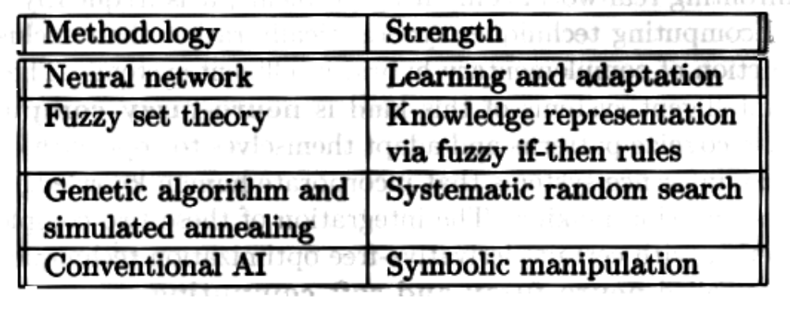
CI constituents (the first three items) and conventional AI

Slide 16
Computational Intelligence is a methodology involves computing with
  An ability to learn
  Adaptation (deal with new situation)

Slide 17
Neural networks
Neural network: information processing paradigm inspired by biological nervous systems, such as our brain
Structure: large number of highly interconnected processing elements (neurons) working together
Like people, they learn from experience (by example)
Indian Institute of Technology Indore

Slide 18
Neural networks
Neural networks are configured for a specific application, such as pattern recognition or data classification, through a learning process
In a biological system, learning involves adjustments to the synaptic connections between neurons
➔ same for artificial neural networks (ANNs)
Indian Institute of Technology Indore

Slide 19
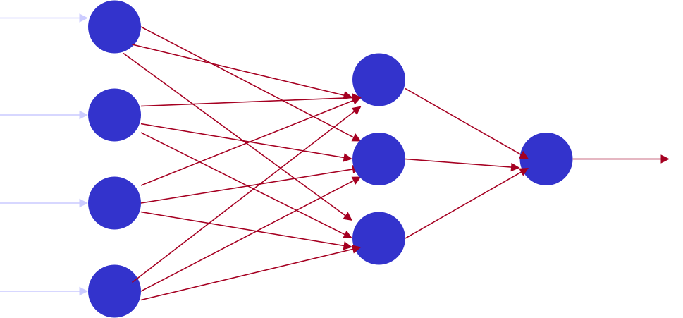
Artificial neural networks
Output
Input
The objective of the neural network is to transform the inputs into meaningful outputs.

Slide 20
Evolving networks
Continuous process of:
  Evaluate output
  Adapt weights
  Take new inputs
ANN evolving causes stable state of the weights, but neurons continue working: network has ‘learned’ dealing with the problem
“Learning”
Notes:
The power of neuron comes from its collective behavior in a network where all neurons are interconnected. The network starts evolving: neurons continuously evaluate their output by looking at their inputs, calculating the weighted sum and comparing to a threshold to decide if they should fire. This is highly complex parallel process whose features can not be reduced to phenomena taking place with individual neurons.
One observation is that the evolving of ANN causes it to eventually reach a state where all neurons continue working but no further changes in their state happen. A network may have more than one stable states, and it is obviously determined (somehow) by the choice of synaptic weights and thresholds for the neurons.

Slide 21
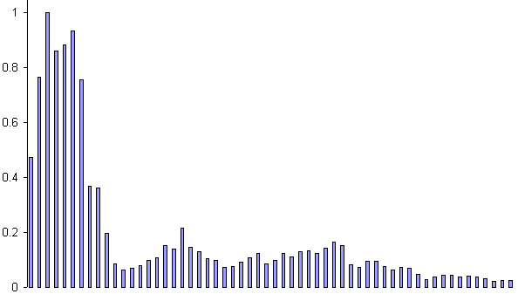
Example: Voice Recognition
Task: Learn to discriminate between two different voices saying “Hello”
Data
  Sources
    Steve Simpson
    David Raubenheimer
  Format
    Frequency distribution

Slide 22
Example: Voice Recognition
Task: Learn to discriminate between two different voices saying “Hello”
Data
  Sources
    Steve Simpson
    David Raubenheimer
  Format
    Frequency distribution

Slide 23
Fuzzy Logic
Professor Lotif Zadeh, UC Berkeley, 1965
  “People do not require precise, numerical information
  input, and yet they are capable of highly adaptive control.”
  -proposed the generalization of classical set theory
Accepts noisy, imprecise input!
Uncertain situation
Indian Institute of Technology Indore

Slide 24
Introduction
Fuzzy logic:
  A way to represent variation or imprecision in logic
  A way to make use of natural language in logic
  Approximate reasoning
Humans say things like "If it is sunny and warm today, I will drive fast"
Linguistic variables:
  Temp: {freezing, cool, warm, hot}
  Cloud Cover: {overcast, partly cloudy, sunny}
  Speed: {slow, fast}

Slide 25
Crisp (Traditional) Variables
Crisp variables represent precise quantities:
  x = 3.1415296
  A ∈{0,1}
A proposition is either True or False
  A ∧ B ⇒ C
King(Richard) ∧ Greedy(Richard) ⇒ Evil(Richard)
Richard is either greedy or he isn't:
  Greedy(Richard) ∈{0,1}

Slide 26
Fuzzy Linguistic Variables
Fuzzy Linguistic Variables are used to represent qualities spanning a particular spectrum
Temp: {Freezing, Cool, Warm, Hot}
Membership Function
Question: What is the temperature?
Answer: It is warm.
Question: How warm is it?

Slide 27
Apparatus of fuzzy logic
  Fuzzy sets: describe the value of variables
  Linguistic variables: qualitatively and quantitatively described by fuzzy sets
  Possibility distributions: constraints on the value of a linguistic variable
  Fuzzy if-then rules: a knowledge
*Fuzzy Logic: Intelligence, Control, and Information - J. Yen and R. Langari, Prentice Hall 1999

Slide 28
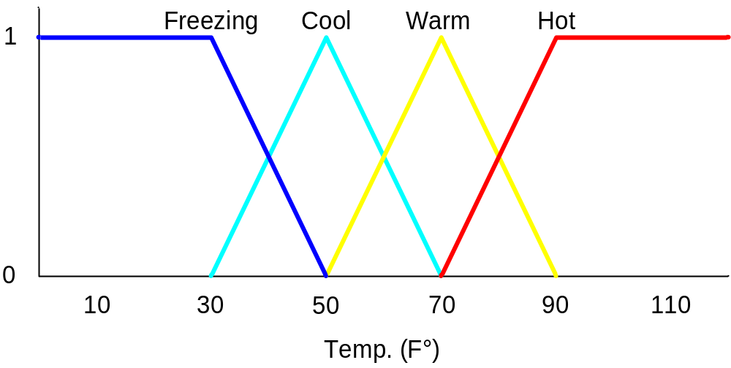
Membership Functions
Temp: {Freezing, Cool, Warm, Hot}
Degree of Truth or "Membership"

Slide 29
Membership Functions
How cool is 36 F° ?

Slide 30
Membership Functions
How cool is 36 F° ?
It is 30% Cool and 70% Freezing
0.7
0.3

Slide 31
Fuzzy Inference Systems
The Architecture of
Fuzzy Inference Systems

Slide 32
Fuzzy Systems
Fuzzifier
Inference
Engine
Defuzzifier
Input
Output
Fuzzy
Knowledge base

Slide 33
Fuzzy Control Systems
Input
Fuzzifier
Inference
Engine
Defuzzifier
Plant
Output
Fuzzy
Knowledge base

Slide 34
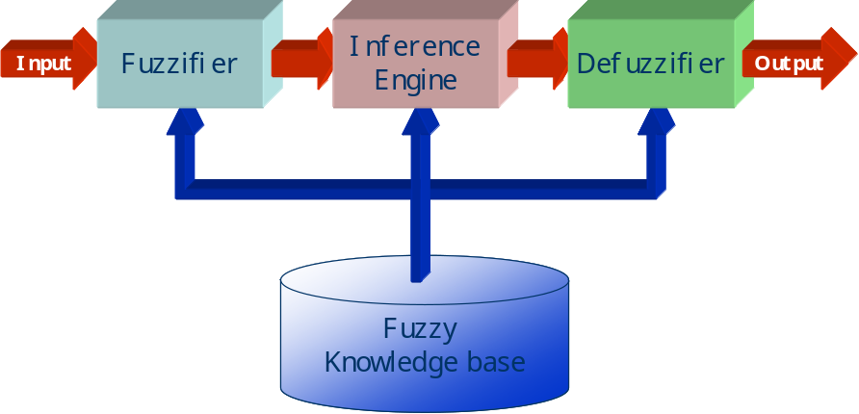
Fuzzifier
Converts the crisp input to a linguistic variable using the membership functions stored in the fuzzy knowledge base.

Slide 35
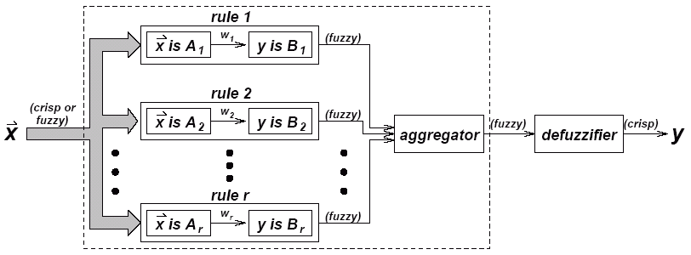
Inference Engine
Using If-Then type fuzzy rules converts the fuzzy input to the fuzzy output.

Slide 36
Defuzzifier
Converts the fuzzy output of the inference engine to crisp using membership functions analogous to the ones used by the fuzzifier.

Slide 37
Fuzzy Control
Fuzzy Control combines the use of fuzzy linguistic variables with fuzzy logic
Example: Speed Control
How fast am I going to drive today?
It depends on the weather.
Disjunction of Conjunctions

Slide 38
Rules
If it's Sunny and Warm, drive Fast
Sunny(Cover)∧Warm(Temp)⇒ Fast(Speed)
If it's Cloudy and Cool, drive Slow
Cloudy(Cover)∧Cool(Temp)⇒ Slow(Speed)
Driving Speed is the combination of output of these rules...

Slide 39
Fuzzification:
Calculate Input Membership Levels
65 F° ⇒ Cool = 0.4, Warm= 0.7

Slide 40
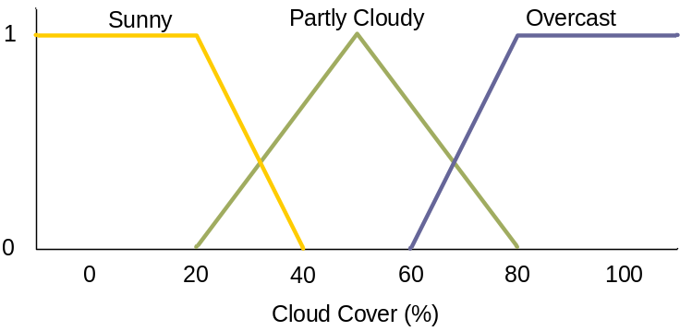
Fuzzification:
Calculate Input Membership Levels
65 F° ⇒ Cool = 0.25, Warm= 0.75
25% Cover ⇒Sunny = 0.8, Cloudy = 0.2

Slide 41
...Calculating...
If it's Sunny and Warm, drive Fast
Sunny(Cover)∧Warm(Temp)⇒Fast(Speed)
0.8 ∧ 0.7 = 0.7
⇒ Fast = 0.7
If it's Cloudy and Cool, drive Slow
Cloudy(Cover)∧Cool(Temp)⇒Slow(Speed)
0.2 ∧ 0.4 = 0.2
⇒ Slow = 0.2

Slide 42
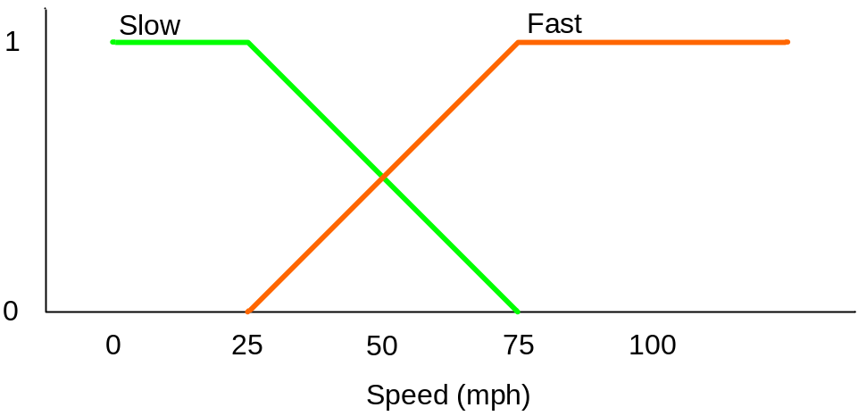
Defuzzification:
Constructing the Output
Speed is 20% Slow and 70% Fast
Find centroids: Location where membership is 100%

Slide 43
Defuzzification:
Constructing the Output
Speed is 20% Slow and 70% Fast
Find centroids: Location where membership is 100%

Slide 44
Defuzzification:
Constructing the Output
Speed is 20% Slow and 70% Fast
Speed = weighted mean
= (2*25+...

Slide 45
Defuzzification:
Constructing the Output
Speed is 20% Slow and 70% Fast
Speed = weighted mean
= (2*25+7*75)/(9)
= 63.8 mph

Slide 46
Notes: Follow-up Points
Fuzzy Logic Control allows for the smooth interpolation between variable centroids with relatively few rules
This does not work with crisp (traditional Boolean) logic
Provides a natural way to model some types of human expertise in a computer program

Slide 47
Notes: Drawbacks to Fuzzy logic
Requires tuning of membership functions
Fuzzy Logic control may not scale well to large or complex problems

Slide 48
Summary
Fuzzy Logic provides way to calculate with imprecision and vagueness
Fuzzy Logic can be used to represent some kinds of human expertise
Fuzzy Membership Sets
Fuzzy Linguistic Variables
Fuzzy AND and OR
Fuzzy Control

Slide 49
Evolutionary Computation
Genetic and Swarm Computing
Indian Institute of Technology Indore

Slide 50
Evolutionary Computation -EC
General term for several computational techniques inspired by biological evolution
Mostly involve meta-heuristic optimization algorithms such as:
  Evolutionary algorithms
    comprising genetic algorithms, evolutionary programming, etc)
  Swarm intelligence
    comprising ant colony optimization and particle swarm optimization)
Indian Institute of Technology Indore

Slide 51
Evolutionary Computation
Inspired by biological genetics
Species survive by reproducing and evolving over time by passing on new information through their genes
  i.e. In genetic algorithm, operators are used to obtain the new child offspring
Indian Institute of Technology Indore

Slide 52
Advantages of CI
Conceptual Simplicity
Broad Applicability
Hybridization with Other Methods
Parallelism
Robust to Dynamic Changes
Solves Problems that have no Solutions
Indian Institute of Technology Indore

Slide 53
Applications
Control
Design
Scheduling
Robotics
Medical
Signal Processing
Game Playing etc.
Indian Institute of Technology Indore

Slide 54
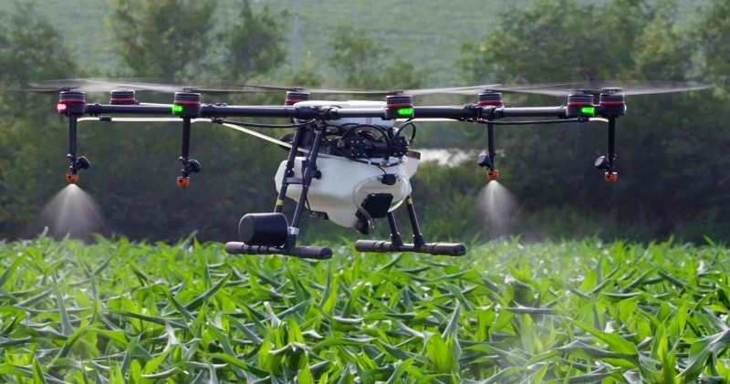
Drone: multiple applications

Slide 55

Recommender System
Indian Institute of Technology Indore

Slide 56
Recent challenges in machine learning….
Concept drift / online learning
Handling big data
Optimization
Hardware realization
Perfomance
Indian Institute of Technology Indore

Slide 57
Thanks
Any Queries ????
Indian Institute of Technology Indore

